Slide 1

The National University of Computer and Emerging Sciences
Programming Fundamentals
CS 1002 Programming Fundamentals
Dr. Akhtar Jamil
Department of Computer Science

Slide 2
Goals
Review of Previous Lecture
Getting started with c++.

Slide 3
Review of Previous Lecture

Slide 4
What is Pseudocode?
English like statements
Each instruction is written on a separate line
Keywords and indentation are used to signify particular control structures.
Written from top to bottom, with only one entry and one exit
Groups of statements may be formed into modules

Slide 5
Some Basic Constructs
Print → Output is to be sent to the Printer
Write → Output is to be written to a file
Display → Output is to be written to the screen
Prompt → required before an input instruction Get, causes the message to be sent to the screen
Compute /Calculate → Calculation performed by computer
Calculation operations: +, -, *, /, ()

Slide 6
Some Basic Constructs
Set → Used to set inital value,
E.g., Set Marks to 0
= → Place values from right hand-side item to left hand side
E.g., Marks = 67
Save → Save the variable in file or disk
E.g., Save Marks

Slide 7
Example Pseudocode Program
A program is required to read three numbers, add them together and print their total.
Inputs | Processing | Output
Number1 Number2 Number3 |  | total

Slide 8
Solution Algorithm
Add_three_numbers
Set total to 0
Read number1
Read number2
Read number3
Total = number1 + number2 + number3
Print total
END

Slide 9
Basic Flowchart Symbols
Name | Symbol | Description
Oval |  | Beginning or End of the Program
Parallelogram |  | Input / Output Operations
Rectangle |  | Processing for example, Addition, Multiplication, Division, etc.
Diamond |  | Denotes a Decision (or branching) for example IF-Then-Else
Arrow |  | Denotes the Direction of logic flow

Slide 10
Example 1
START
Step 1: Input M1,M2,M3,M4
Step 2: GRADE = (M1+M2+M3+M4)/4
Step 3: if (GRADE < 50) then
Print “FAIL”
else
Print “PASS”
endif
Input
M1,M2,M3,M4
GRADE←(M1+M2+M3+M4)/4
IS
GRADE<50
No
Yes
Print
“PASS”
Print
“FAIL”
STOP

Slide 11
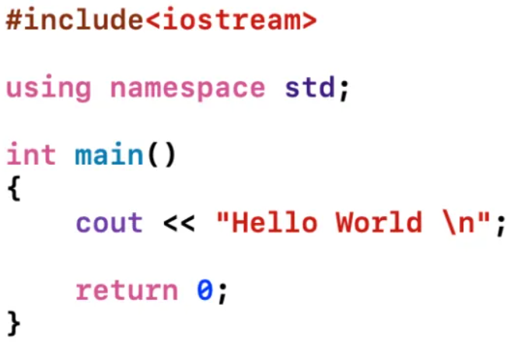
First C++ Program
Preprocessor Directive
Standard Namespace
main function
Print message on screen
end main function

Slide 12
Today’s Lecture

Slide 13
History
C evolved from two languages (BCPL and B)
1980: “C with Classes”
1985: C++ 1.0
1995: Draft standard
Developed by Bjarne Stroustrup at Bell Labs
Based on C, added Object-Oriented Programming concepts (OOP) in C
Similar program performance (compared to C)

Slide 14
C vs. C++
Advantages:
1. Faster development time (code reuse)
2. Creating / using new data types is easier
3. Easier memory management
4. Stricter syntax & type checking => less bugs
5. Easier to implement Data hiding
6. Object Oriented concepts

Slide 15
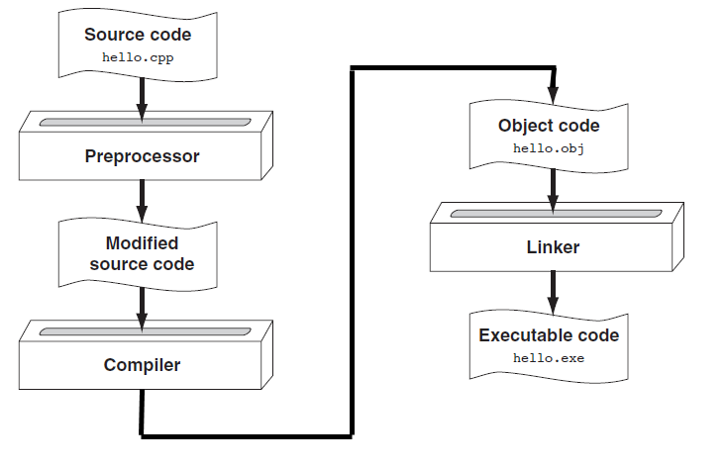
C++ Program Compilation

Slide 16
From a High-level Program to an Executable File
Create file containing the program with a *text editor (e.g., pico, gedit, etc.)
Run preprocessor to convert source file directives to source code program statements (#include lines).
Run compiler to convert source program statements into machine instructions (g++).
*For more information: https://linuxhint.com/best-text-editors-for-ubuntu/

Slide 17

From a High-level Program to an Executable File
Run linker to add/connect hardware-specific library code to machine instructions, producing an executable file. (g++)
Steps: b) through d) are often performed by a single command or button click (such as g++).
Errors occurring at any step will prevent execution of the step that follows.
Compiling a C++ program:
g++ -o first.exe hello.cpp
Note →

Slide 18
What Is a Program Made Of?
Common elements in programming languages:
Key/reserved words (predefined meaning)
Programmer-defined identifiers (rules apply)
Operators (e.g., + for “add, * for multiply)
Punctuation (symbols that organize, e.g., comma (,), semicolon(;), parentheses, etc.)
Syntax ( rules of “grammar” )
Notes:
See pr1-01.cpp

Slide 19
C++ Program
Preprocessor Directive
Standard Namespace
main function
Print message on screen
end main function

Slide 20
Preprocessor Directives
#include<iostream>
# is a preprocessor directive
The preprocessor runs before the actual compiler and prepares your program for compilation.
Lines starting with # are directives to preprocessor to perform certain tasks, e.g., “include” command instructs the preprocessor to add the iostream library in this program

Slide 21
namespace
A namespace is a declarative region that provides a scope to the identifiers
the names of types, functions, variables, etc. inside it.
Namespaces are used to organize code into logical groups and to prevent name collisions.
Example: We cannot create two variables with same name, but within different name spaces we can create.

Slide 22
main( ) function
Every C++ program start executing from main ( )
A function is a construct that contains/encapsulates statements in a block.
Block starts from “{“ and ends with “}” brace
Every statement in the block must end with a semicolon ( ; )
Examples…

Slide 23
Example Program 1
#include <iostream>
using namespace std;
int main()
{
int num1 = 5, num2, sum;
num2 = 12;
sum = num1 + num2;
cout << "The sum is " << sum;
return 0;
}

Slide 24
Example Program 2
#include <iostream>
using namespace std;
int main()
{
int num1 = 5, num2, sum;
cout << “Enter second number: “;
cin >> num2
sum = num1 + num2;
cout << “The sum is “ << sum;
return 0;
}

Slide 25
Key Words
Also known as reserved words
Have a special meaning in C++
Can not be used for another purpose
Written using lowercase letters
Examples in program (shown in green):
using namespace std;
int main()

Slide 26
Some C++ Reserve Words
auto break
case char
const continue
default do
double else
enum extern
float for
goto if
int long
register return
short signed
sizeof static
struct switch
typedef union
unsigned void
volatile while

Slide 27
Programmer-Defined Identifiers
Names made up by the programmer
Not part of the C++ language
Used to represent various things, such as variables (memory locations)
Example in program (shown in green):
int num1;

Slide 28
Practices Tasks
Complete the two tasks given in the last lecture (if not completed today)
Write a pseudocode and flowchart for a program to take birth year as input and print the age as output.
Write a pseudocode and flowchart for a program that asks the user to enter his marks and print the GPA according to following table:
Marks | GPA
90 or above | 4.0
80 - 89 | 3.5
70 - 79 | 3.0
69 or less | 0.0

Slide 29
References
Credit goes to Dr. Muhammad Aleem for preparation of slides
Text book: Starting out with c++

Slide 30
Thank You ☺

